Slide 1
Wages
Pub 4012 – Tab D
Pub 4491 – Lesson 9
Notes:
Core Slides: 1-20
Comprehensive Slides: 21-40
Instructors can
Direct learners to TaxSlayer Practice Lab Video “Entering basic income” for prep homework
Encourage use of P4012 for software assistance

Slide 2
Lesson Topics
Interview techniques
W-2 income
TaxSlayer entry
Comprehensive topics
ITIN W-2
Substitute W-2
3rd party sick pay
Unreported tip income
Scholarship income
Household employee
Prison income

Slide 3
Learning Objectives – Wages
Explore questions for taxpayers to understand W-2 elements and identify out of scope situations
Report income correctly on Form 1040
Discover Form W-2 references and learning tools

Slide 4
Wages – The Interview
Page 2 of Intake/Interview & Quality Review – Form 13614-C
Notes:
Encourage Counselors to ask probing questions
It is not “prying;” it is essential to an accurate return

Slide 5
The Interview – A Conversation
Intake form and Forms W-2 or other records
Household employee (no W-2)
Prior year’s return helpful
Forms 1098-T (scholarship exceeds expenses)
At interview, identify possible scholarship income; finalize later when you enter education benefits
Notes:
Emphasize:
Steps and questions to determine whether in scope, before touching the computer
Prior year’s return
Review all income areas to understand the taxpayer’s tax situation
Most taxpayers’ situation does not vary much year to year
Was there household worker income reported last year?
W-2 forms
Is it the right year?
Does the form look legit?
Look for out-of-scope items (detailed later)
Is it the right SSN or does TP have an ITIN?
Household employees – discussed later
1098-T form
Does scholarship amount exceed expenses?
Is any of it for the prior year and education credit was claimed in prior year?
May need to recapture some of the credit – out of scope
If unsure, reassure participants that LC or QR person can help!

Slide 6
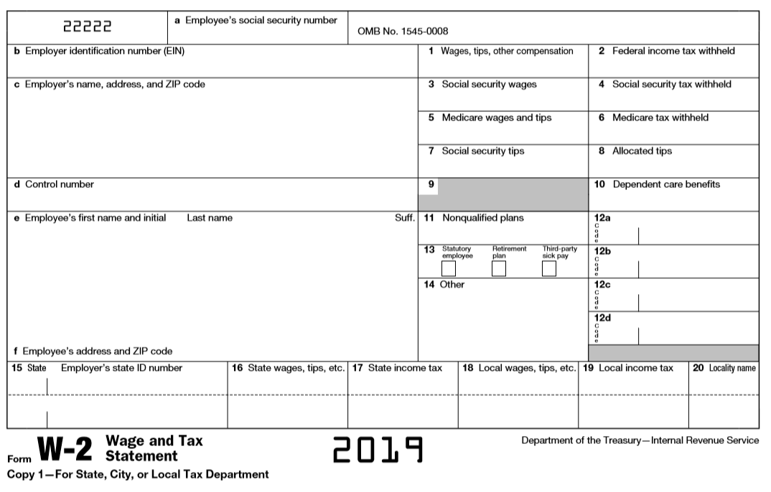
Entering W-2
Verify current tax year
Notes:
Emphasize
Every labeled box must be input
Taxpayers sometimes bring in prior year W-2s by mistake so be careful

Slide 7
Interview: Missing W-2
Taxpayer “should” receive W-2 by early February but may be later
Taxpayer should contact employer first if W-2 not received by 02/15/2020
Use substitute W-2 to complete return if employer contact unsuccessful
Must have pay stub with full-year cumulative information
Notes:
Taxpayer keeps a copy of Form 4852 for their records.
If employer has ceased operations – taxpayer should also file a copy with Social Security Administration
If the taxpayer has an ITIN – do not enter the SS# on the 4852 – the return is filed with the ITIN only
Household employees – discussed later

Slide 8
Entering W-2 into TaxSlayer
Completely enter information on each W-2 before going to next one
Double check employer ID numbers, names and addresses
Correct any auto-populated information
Social Security and Medicare wages (and taxes) may differ from taxable wages
Same for state information
May need manual adjustment if state wages differ
Changing here may not change the state

Slide 9
Entering W-2 into TaxSlayer
Control number not needed
Standard W-2 is default
If corrected W-2, click the box
Substitute generates Form 4852

Slide 10
W-2 Box 12 codes
Often seen codes (26 possible codes):
D – Elective deferrals to 401(k) retirement plan
E through H -Elective deferrals to other qualified plans
DD – Cost of employer-sponsored health coverage
Careful: don’t confuse D and DD
Notes:
Code D will add Form 8880 to the return (may need to make additional entries to it)
Code DD is informational only and does not affect the income tax return
All codes as shown on W-2 should be input into TaxSlayer (or “other” in box 14 data, if needed)

Slide 11
W-2 Box 14
Some employers put retirement plan in box 14
Use best choice in drop-down list
Notes:
If box 14 has “401k”
Leave in box 14 and select from drop-down list that it qualifies or not for Form 8880 retirement savers credit (next slide)

Slide 12
W-2 – Box 13
Statutory employee – special status
FICA taxes taken out by employer
Taxpayer can report income and deduct expenses using Schedule C
TaxSlayer moves income from Line 1 to Schedule C when box is checked (see business income lesson) W-2 – Box 13
Retirement plan – participant
See IRA deduction in adjustments lesson
3rd Party sick pay
Reports outside insurer payments
Notes:
With Statutory Employee checked, clicking Continue, should cause TaxSlayer to ask if want to now go to Schedule C (see Business Income lesson)
Click Continue again to complete the W-2 and move through the return

Slide 13
Other Wages Income – Disability Pension
Pub 4012 Tab D
Taxpayers under minimum retirement age for employer plan
Pension taxed as wages (see retirement income lesson)
Form 1099-R, Distribution Code 3 – Follow Pub 4012 instructions to identify when/how to recognize income as disability
Income eligible for EIC
Notes:
Emphasize
The interview should have already identified that the 1099-R has code 3
Can look at the prior year’s return for confirmation
Must still ask the question
Once Taxpayer reaches the minimum retirement age, distribution will remain as retirement income
Some employers report using W-2 instead of 1099-R and that is ok

Slide 14
W-2 Scope Limitation
W-2 Box 12 out of scope for:
Code FF and is eligible for premium tax credit (Form 8962)
Code R – Archer Medical Savings Acct (MSA)
Code T – adoption benefits
Code Q – nontaxable combat pay (unless certified for Military)
Code W – employer contribution to Health Savings Acct (unless certified for HSA)
Notes:
If possible, show participants how to look up the instructions in Pub 4012, TaxSlayer, or IRS.gov form W-2 to see all the box 12 codes (https://www.irs.gov/pub/irs-pdf/iw2w3.pdf)

Slide 15
W-2 Scope Limitation (cont.)
Ministers/church workers’ returns are out of scope – special tax rules
Very high income that is subject to the additional Medicare tax is out of scope
MFJ: $250,000
MFS: $125,000
S, HoH or QW: $200,000
Notes:
Ministers or certain church works
This may be noted in box 14

Slide 16
Quality Review – Wages
Verify all W-2 data has been input correctly
Employer Identification Number (EIN)
Employer name
Employer address
Social Security/Medicare amounts
All box 12 items
Statutory employee/retirement/3rd party sick

Slide 17
Quality Review – Wages
Confirm wages line includes all income
All jobs or W-2s entered
Per Intake/Interview/QR form
Compare to prior year
Confirm prisoner income is properly treated as unearned income

Slide 18
Quality Review – Wages
After all other aspects of return are done, confirm wages line complete
Tips from Form 4137
Household worker income
Disability pension
Taxable scholarships
Notes:
This part of QR is done at the end, after all items have been input

Slide 19
Quality Review – Wages
Wage income may trigger other aspects in return
Proceed methodically through each
e.g. IRA contributions or deductions, retirement saving credit, EIC
All covered in separate lessons
Notes:
Saving for retirement is mentioned here to get thought going as the return is being prepared
It is the taxpayer’s responsibility to manage their tax affairs
May remind them of opportunities to reduce their taxes if they are eligible

Slide 20
Taxpayer Summary – Wages
Make correcting entries in Intake Booklet
When return complete review withholding with taxpayer
Can change using W-4 with employer
IRS has withholding calculator on irs.gov
Notes:
Emphasize
Any corrections needed must be noted on the I&I form
The real exit interview is done at the end of the return preparation process
These exit interview comments are to highlight topics specific to Wages

Slide 21
Wages
Comprehensive Topics
Notes:
All Counselors need to be aware of comprehensive topics
Experienced counselors should be well-versed and able to find guidance in pub 4012
Topics considered comprehensive (some because they are rarely seen):
ITIN returns
Substitute W-2 – Form 4852
Zero-wages W-2
Tip income
Taxable scholarships
Household worker wages
Prisoner income
Medicaid waiver wages – see separate lesson

Slide 22
Comprehensive Topics
ITN W-2
Substitute W-2
3rd party sick pay
Unreported tip income
Scholarship income
Household employee income
Prison income

Slide 23
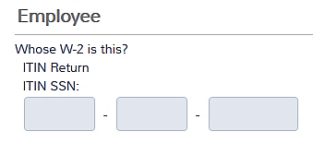
ITIN* Returns
TaxSlayer recognizes ITIN return
ITIN returns can be e-filed
W-2 may have erroneous SSN
Enter SSN on W-2
Not eligible for all benefits (e.g. EIC)
* IRS assigned ID number, not a social security number
Notes:
Emphasize
ITIN returns can be e-filed
Not be eligible for all benefits (e.g. EIC)

Slide 24
Substitute W-2
Complete W-2 using prior year W-2 employer data or last pay check stub
Taxpayer provides year-end totals if not on pay stub
If taxpayer provides copy of Form 4852, transfer to TaxSlayer

Slide 25
Substitute W-2 (cont.)
TaxSlayer: substitute W-2 leads to Form 4852 questions
If taxpayer gets W-2 later with different information, may need to amend return
Taxpayer reports FICA taxes paid to Social Security Administration

Slide 26
Entering Zero Wage W-2 – Special Situation
W-2 with zero wages (Box 1)
May be reporting sick or disability pay
Need to enter only if tax withheld
Cannot enter zero-wage W-2 into TaxSlayer
Cannot enter withholding > wages without amount in Box 1
Enter withheld tax per W-2:
Go to Payments and Estimates > Other Federal Withholding
Notes:
Rare situation
Always check with LC/ QR for guidance if unsure

Slide 27
Tip Income
All tip income is taxable
Employees report tips to employer
If reported tips are greater than $20 any month, they are included on W-2, boxes 1, 5, and 7
Some employers use IRS approved program to “allocate tips” for employees W-2
Notes:
If taxpayer is in an occupation that receives tips, inquiry should be made
Pub 531 Reporting Tip Income
IRS prints free tip logs that Taxpayers can order from IRS.gov or by phone

Slide 28
Allocated Tips – W-2 box 8
Employer elects allocated tips method (employer not relying on employee reporting of tips)
Not included in W-2, box 1 or 3
TaxSlayer adds allocated tip amount to Form 1040 wages and completes Form 4137
Taxpayer can use “employee’s reliable written record” if different than Allocated Tips in W-2, box 8
Can add incremental tips as “unreported” on W-2 screen
May need to change allocated tips in box 8 if less than allocated
Notes:
The law says Allocated tips are at least 8% unless employee keeps a good log

Slide 29
Unreported Tips
Pub 4012 Tab D
Tips not reported to employer
Ask taxpayer if they have tip income not reported to employer
Include noncash tips as taxable income at fair market value
If taxpayer is self-employed, include tips on Schedule C
Subject to federal income tax
TaxSlayer: find on Wages Input Sheet directly enter

Slide 30
Unreported Tips
Pub 4012 Tab D
Tips less than $20 per month not reported to employer:
Subject to federal income tax
Not subject to Social Security and Medicare taxes
TaxSlayer: enter on W-2 input screen and directly on Form 4137
Other Taxes > Tax on Unreported Tip Income (Form 4137)

Slide 31
Summary – Allocated and Unreported Tips
Tip Income in wages line:
+ W-2, Box 1, Wages & tips
+ W-2, Box 8, Allocated tips
+ Unreported tips from
TaxSlayer W-2 Input
= Taxable Income for Tips
Form 4137:
+ W-2, Box 8, Allocated tips
+ Unreported tips from TaxSlayer W-2 Input
- Unreported tips < $20/month
= Unreported Income for Social Security Tax

Slide 32
Taxable Scholarships or Grants – Not on W-2
Scholarships and Grants
TaxSlayer: Income > Other Compensation
Income always goes on student’s return, not the taxpayer claiming the student as a dependent
Notes:
The amount of taxable scholarships is input after all other items have been entered.

Slide 33
Taxable Scholarship or Grants – Not on W-2
Earned income for
Filing requirement
Standard deduction calculation
Unearned income for all other purposes
Kiddie tax, EIC, child tax credit, dependent care credit, etc.
Notes:
Scholarship income is considered earned income when determining the filing requirement
Once there is a filing requirement and the scholarship income is entered on the tax return, scholarship income becomes unearned income
Scholarship income of $10,000 (considered earned income when determining filing requirement) alone – student has no other income – will not trigger a filing requirement: Single student not required to file
Scholarship income of $10,000 and W-2 income of $3,000 exceeds filing requirement threshold: Single student is required to file
And this may be a kiddie tax return because student has $10,000 of (now) unearned scholarship income

Slide 34
Household Employee – Income Not on W-2
Amount less than $2,100 per employer for 2019
No withholding or FICA taxes apply
Can have multiple employers so long as each less than $2,100 (enter total amount)
If household employee income not on W-2 is more than $2,100 per employer, TP may show as a business
See business income lesson
Notes:
Informational:
Payers who pay more than $2,100 in the year or cash wages of $1,000 in a quarter must file Schedule H and pay the employment taxes for their household employee
Sch H is out of scope
Payees must report all their income, even if below the employer reporting limit
Informational note W-2:
No withholding or FICA taxes apply to employee who is related to the employer as:
Spouse, child under age 21, (some) parents, or anyone under age 18
Cannot be the employee’s principal occupation (not a test for students)
See Pub 926
Some household workers are self-employed, Schedule C

Slide 35
Household Employee – Income Not on W-2
Household workers can include
Housekeepers
Nannies
Babysitters
Caregivers
Among others

Slide 36
Prisoner Earned Income
Income earned while
An inmate in a penal institution
In a work release program
While in a halfway house
Not treated as earned income for child and dependent care, earned income credit, or additional child tax credits

Slide 37
Prisoner Earned Income
Pub 4012 Tab D
After inputting W-2, go to TaxSlayer > Income > Other Compensation > Prisoner Earned Income
Input total prisoner earned income as a positive amount
TaxSlayer reduces the earned income applicable for:
Child and dependent care credit
Earned income credit
Additional child tax credit
Does not reduce taxable income

Slide 38
Prisoner Earned Income Example
Joe has W-2 income of $10,000, of which $9,000 was during work release
Enter W-2 as normal
Enter $9,000 as prisoner earned income
Earned income is reduced to $1,000 for the credits
Taxable wages remain $10,000

Slide 39
Medicaid Waiver Payments Reported on W-2
See separate Other Income – Medicaid Waiver lesson
Payments described in Notice 2014-7 are
Excludible from gross income as difficulty of care payments
Not earned income for earned income credit, dependent care credit, or additional child tax credit
June 2019 Tax Court decision allowed taxpayer to include MWP as earned income for EIC – IRS has not revised Notice 2014-7 – awaiting IRS guidance on how to proceed

Slide 40
Income – Wages
Questions?
Comments?

